Slide 1
P11 Making Sense of Things 6th Presentation
A113 – Mathematics

Slide 2
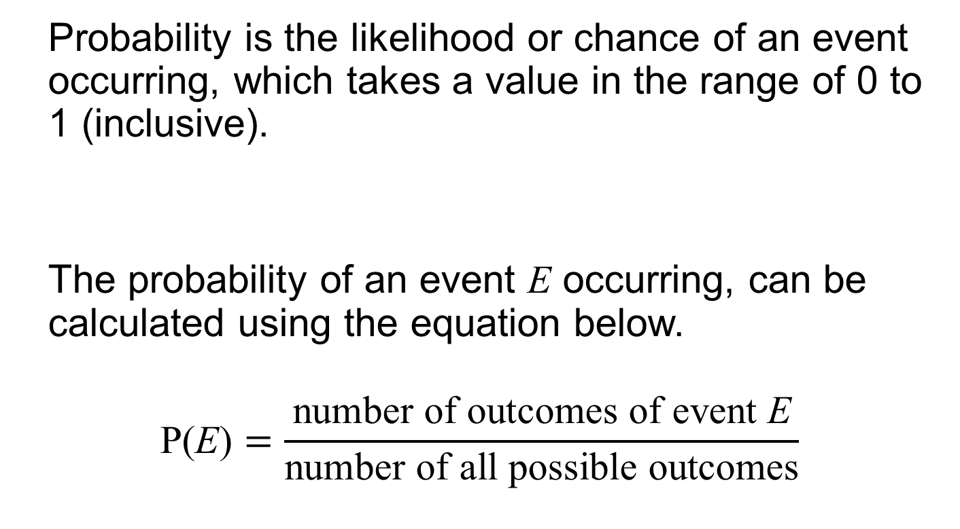
Probability
Probability is the likelihood or chance of an event occurring, which takes a value in the range of 0 to 1 (inclusive).
The probability of an event E occurring, can be calculated using the equation below.
$$\text{P}\text{(}\text{E}\text{)}=\frac{\text{number} \text{of} \text{outcome}\text{s} \text{of} \text{event} \text{E}}{\text{number} \text{of} \text{all} \text{possible} \text{outcome}\text{s}}$$

Slide 3



Case Study 1: Game Show
One or Two Dice???
Should the contestant use one or two dice to increase his/her chance of rolling a total score of ‘6’ and winning the $1000 cash?
The dice are fair and six-sided.
Fair or unbiased implies that the probability of each outcome is equal

Slide 4
Strategy 1: One Die
Total Score | Probability of getting the Total Score
‘1’ | 1/6
‘2’ | 1/6
‘3’ | 1/6
‘4’ | 1/6
‘5’ | 1/6
‘6’ | 1/6
Sum of probabilities | 1

Slide 5
Strategy 2: Two Dice
Total Score/ Outcome | Possible Arrangement(s) | Number of Possible Arrangement (s) | Probability of getting the Total Score
‘2’ | (1,1) | 1 | 1/36
‘3’ | (1,2) (2,1) | 2 | 2/36
‘4’ | (1,3) (3,1) (2,2) | 3 | 3/36
‘5’ | (1,4) (4,1) (3,2) (2,3) | 4 | 4/36
‘6’ | (1,5) (5,1) (4,2) (2,4) (3,3) | 5 | 5/36
‘7’ | (1,6) (6,1) (5,2) (2,5) (4,3) (3,4) | 6 | 6/36
‘8’ | (2,6) (6,2) (5,3) (3,5) (4,4) | 5 | 5/36
‘9’ | (3,6) (6,3) (4,5) (5,4) | 4 | 4/36
‘10’ | (4,6) (6,4) (5,5) | 3 | 3/36
‘11’ | (5,6) (6,5) | 2 | 2/36
‘12’ | (6,6) | 1 | 1/36
Sum of probabilities | 1

Slide 6
Case Study 1: Game Show
Strategy 1: One Die
Probability of getting a total score of ‘6’ = 1/6
Strategy 2: Two Dice
Probability of getting a total score of ‘6’ = 5/36
The contestant has a higher chance of winning the $1000 cash if he/she chooses to use one die.

Slide 7
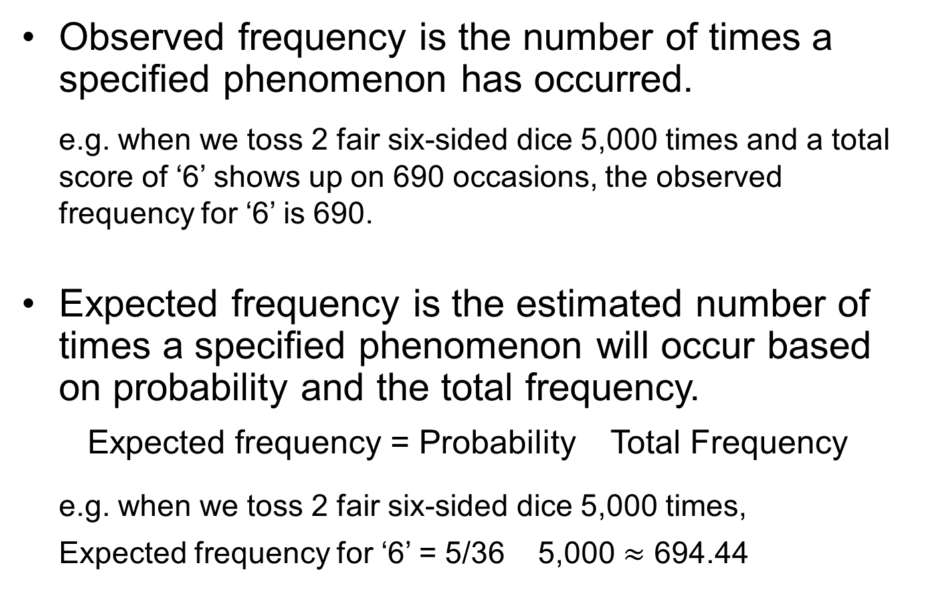
Observed and Expected Frequency
Observed frequency is the number of times a specified phenomenon has occurred.
e.g. when we toss 2 fair six-sided dice 5,000 times and a total score of ‘6’ shows up on 690 occasions, the observed frequency for ‘6’ is 690.
Expected frequency is the estimated number of times a specified phenomenon will occur based on probability and the total frequency.
Expected frequency = Probability Total Frequency
e.g. when we toss 2 fair six-sided dice 5,000 times,
Expected frequency for ‘6’ = 5/36 5,000 $≈$ 694.44

Slide 8
Observed and Expected Frequency
If we simulate the tossing of two fair dice 5,000 times, we obtain the distribution of the frequency of the total score as shown:
When a large number of trials is performed, the observed frequency is very close to the expected frequency.
Total Score | Expected Frequency | Observed Frequency
‘2’ | 138.89 | 130
‘3’ | 277.78 | 279
‘4’ | 416.67 | 424
‘5’ | 555.56 | 558
‘6’ | 694.44 | 690
‘7’ | 833.33 | 822
‘8’ | 694.44 | 702
‘9’ | 555.56 | 552
‘10’ | 416.67 | 414
‘11’ | 277.78 | 289
‘12’ | 138.89 | 136
Expected Frequency
Total Score

Slide 9

Case Study 2: Hepatitis-C
What is the chance that Joshua has the Hepatitis-C virus, given that he was tested positive?
The test kit is 97% accurate in giving the correct test result
Singapore has a population of 5,600,000
0.5% of the population in Singapore is infected with the Hepatitis-C virus

Slide 10
Probability Tree Diagram
Tested
positive
(27,160)
97%
Infected with
Hepatitis-C
( 28,000 )
0.5%
3%
Tested
negative
( 840 )
Population
(5,600,000)
Tested
positive
(167,160)
99.5%
3%
Not Infected with
Hepatitis-C
( 5,572,000 )
97%
Tested
negative
(5,404,840)

Slide 11
Conditional Probability
Conditional probability is the probability that an event will occur, when another event is known to occur or to have occurred.
The probability of event A occurring, given that event B has occurred, can be calculated using the equation below.

Slide 12
Conditional Probability
Tested
positive
(27,160)
97%
Infected with
Hepatitis-C
( 28,000 )
0.5%
3%
Tested
negative
( 840 )
Population
(5,600,000)
Tested
positive
(167,160)
99.5%
3%
Not Infected with
Hepatitis-C
( 5,572,000 )
97%
Tested
negative
(5,404,840)
P(one is infected with Hepatitis-C given that he is tested positive)
or

Slide 13
Conditional Probability
Tested
positive
(27,160)
97%
Infected with
Hepatitis-C
( 28,000 )
0.5%
3%
Tested
negative
( 840 )
Population
(5,600,000)
Tested
positive
(167,160)
99.5%
3%
Not Infected with
Hepatitis-C
( 5,572,000 )
97%
Tested
negative
(5,404,840)
P(one is tested positive given that he is infected with Hepatitis-C)
or

Slide 14
Conditional Probability
P(one is infected with Hepatitis-C given that he is tested positive)
P(one is tested positive given that he is infected with Hepatitis-C)
The probability of Event A occurring given that Event B has occurred is NOT the same as the probability of Event B occurring given that Event A has occurred.

Slide 15
Worked Example (Practice Question Q1)
The events A and B are said to be mutually exclusive if they cannot happen together at the same time or they have no outcomes in common.
Are the following events mutually exclusive?
The event ‘getting a head’ and the event ‘getting a tail’ when tossing a fair coin. Yes
The event ‘getting a 3’ and the event ‘getting a 4’ when rolling a fair six-sided die. Yes
The event ‘getting a King’ and the event ‘getting a Spade’ when drawing a card from a standard deck of 52 poker cards. No

Slide 16
Worked Example (Practice Question Q2)
The events A and B are independent if the occurrence of one is not affected by the occurrence of the other.
Are the following events independent?
Rolling a fair six-sided die three times. Yes
Taking 2 balls, one each from 2 different boxes. Yes
Taking 2 balls from the same box, one after the other, with replacement. Yes
Taking 2 balls from the same box, one after the other, without replacement. No

Slide 17
Worked Example (Practice Question Q10)
A unfair eight-sided die, numbered 1,1,2,4,5,6,7,7, is thrown.
What is the probability of a number 1 appearing on a throw, given that an odd number has appeared on the throw?
b) Given that an even number has appeared on the throw, what is the probability of a number 4 appearing on the throw?
1
1
1
1
5
7
7
4
2
4
6

Slide 18
Worked Example (Practice Question Q10)
It is known that a number 4 has appeared on the throw. What is the probability of an even number appearing on the throw?
4
4

Slide 19
Worked Example (Practice Question Q13)
Bus is Late
0.25
Rainy Day
0.3
0.75
Bus is Punctual
Note:
AND →
OR →
Bus is Late
0.7
0.05
Sunny Day
0.95
Bus is Punctual
P(Bus is punctual on a day)
= P[(Rainy AND Punctual) OR (Sunny AND Punctual)]
=
=

Slide 20
Worked Example (Practice Question Q13)
Bus is Late
0.25
Rainy Day
0.3
0.75
Bus is Punctual
Bus is Late
0.7
0.05
Sunny Day
0.95
Bus is Punctual
P(Rainy | Punctual)

Slide 21
Learning Objectives
Verify the probability of an event occurring by repeating the same experiment a large number of times.
Recognise that the observed frequency will be close to the expected frequency if a large number of trials is conducted.
Determine if two events are independent or dependent.
Perform calculations on and analyse cases involving conditional probability.
Use probability tree diagram to analyse the probability of some event occurring.

Slide 22
Exploring Further
Option A
Total Score | Possible Arrangement(s) | Number of Possible Arrangement(s) | Probability of getting the Total Score
‘2’ | (1,1) | 1 | 1/36
‘3’ | (1,2) (2,1) | 2 | 2/36
‘4’ | (1,3) (3,1) (2,2) | 3 | 3/36
‘5’ | (1,4) (4,1) (3,2) (2,3) | 4 | 4/36
‘6’ | (1,5) (5,1) (4,2) (2,4) (3,3) | 5 | 5/36
‘7’ | (1,6) (6,1) (5,2) (2,5) (4,3) (3,4) | 6 | 6/36
‘8’ | (2,6) (6,2) (5,3) (3,5) (4,4) | 5 | 5/36
‘9’ | (3,6) (6,3) (4,5) (5,4) | 4 | 4/36
‘10’ | (4,6) (6,4) (5,5) | 3 | 3/36
‘11’ | (5,6) (6,5) | 2 | 2/36
‘12’ | (6,6) | 1 | 1/36
P(Total score of ‘7’) = 6/36 = 1/6

Slide 23
Exploring Further
Option B
Total Score | Possible Arrangement(s) | Number of Possible Arrangement(s) | Probability of getting the Total Score
‘2’ | (1,1) | 1 | 1/36
‘3’ | (1,2) (2,1) | 2 | 2/36
‘4’ | (1,3) (3,1) (2,2) | 3 | 3/36
‘5’ | (1,4) (4,1) (3,2) (2,3) | 4 | 4/36
‘6’ | (1,5) (5,1) (4,2) (2,4) (3,3) | 5 | 5/36
‘7’ | (1,6) (6,1) (5,2) (2,5) (4,3) (3,4) | 6 | 6/36
‘8’ | (2,6) (6,2) (5,3) (3,5) (4,4) | 5 | 5/36
‘9’ | (3,6) (6,3) (4,5) (5,4) | 4 | 4/36
‘10’ | (4,6) (6,4) (5,5) | 3 | 3/36
‘11’ | (5,6) (6,5) | 2 | 2/36
‘12’ | (6,6) | 1 | 1/36
P(Total score of ‘10’ or ’11’ or ‘12’) = 3/36 + 2/36 + 1/36 = 1/6

Slide 24
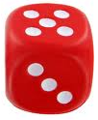
Exploring Further
Given that a ‘5’ is rolled on the first die:
Option A
+ ?
Total Score | Possible Arrangement(s) | Number of Possible Arrangement(s) | Probability of getting the Total Score
‘6’ | (5,1) | 1 | 1/6
‘7’ | (5,2) | 1 | 1/6
‘8’ | (5,3) | 1 | 1/6
‘9’ | (5,4) | 1 | 1/6
‘10’ | (5,5) | 1 | 1/6
‘11’ | (5,6) | 1 | 1/6
P(Total score of ‘7’) = 1/6

Slide 25
Exploring Further
Given that a ‘5’ is rolled on the first die:
Option B
+ ?
Total Score | Possible Arrangement(s) | Number of Possible Arrangement(s) | Probability of getting the Total Score
‘6’ | (5,1) | 1 | 1/6
‘7’ | (5,2) | 1 | 1/6
‘8’ | (5,3) | 1 | 1/6
‘9’ | (5,4) | 1 | 1/6
‘10’ | (5,5) | 1 | 1/6
‘11’ | (5,6) | 1 | 1/6
P(Total score of ‘10’ or 11) = 1/6 + 1/6 = 1/3

